Slide 1
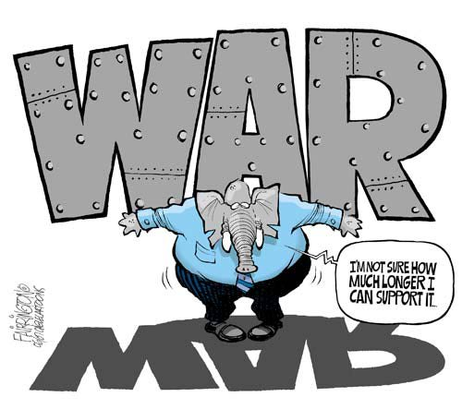
How Word Frequency can be used to Predict war
Kayla Jordan & Erin Buchanan
Missouri State University
0.tqn.com/d/politicalhumor/1/0/L/k/1/republican_war_support.jpg

Slide 2
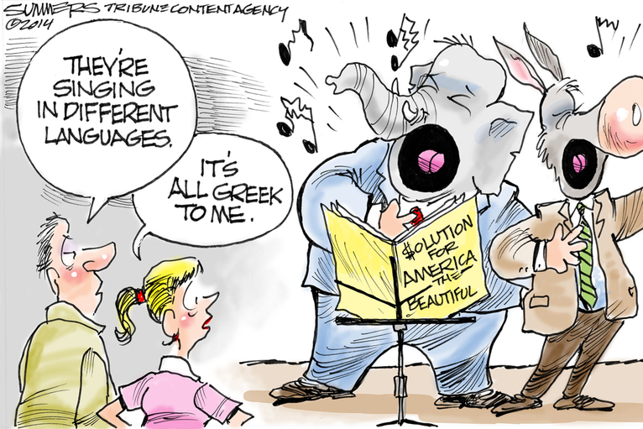
Language
Source of abundantly available data
Predictive of psychological constructs
Attentional Focus
Euphemisms and hate speech
Terrorist Networks

Slide 3
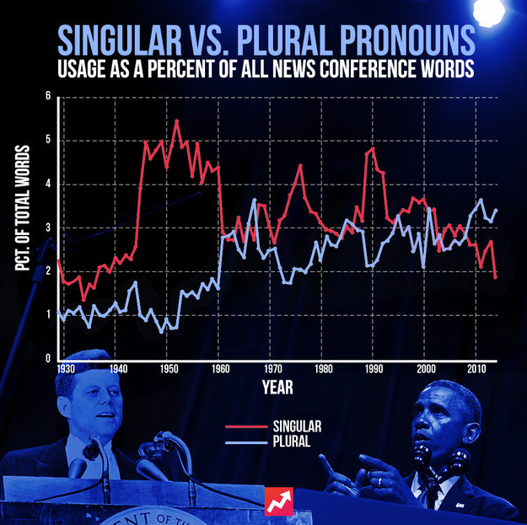
Is Obama a narcissist?
Not due to pronouns anyway…

Slide 4
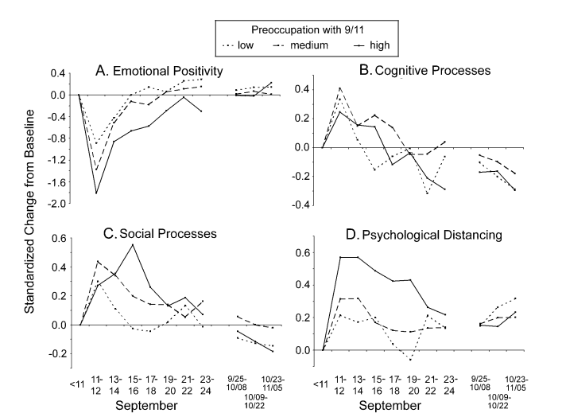
Livejournal + 2001 = Interesting stuff

Slide 5
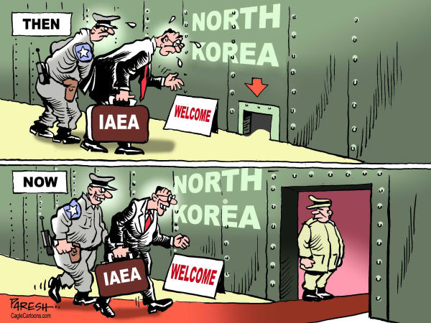
Purpose
Study 1: Can word counts be used to predict voting behavior?
Study 2: What are the linguistic changes in the foreign policy discourse in Congress?

Slide 6
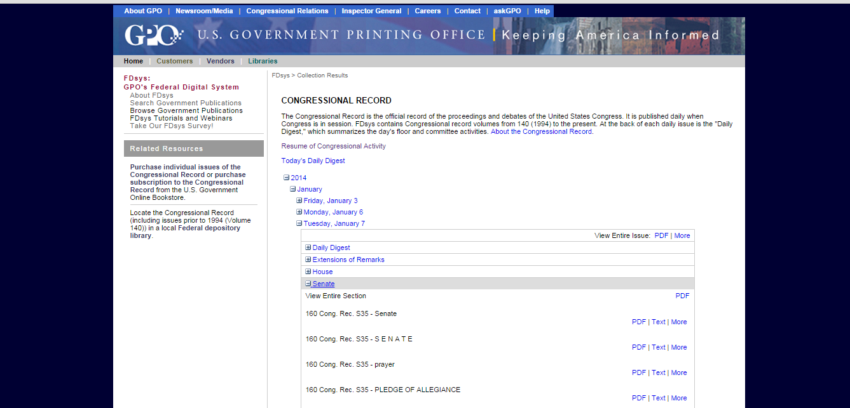
Congressional Record

Slide 7
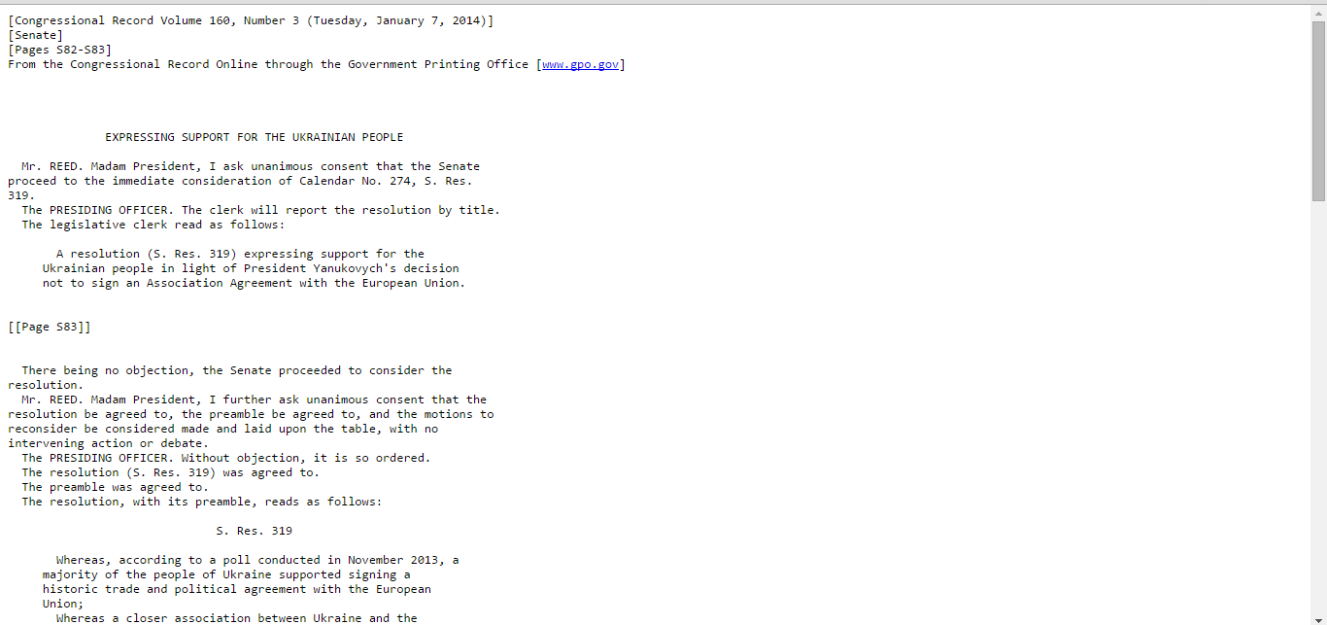
Congressional Record Entry

Slide 8
LIWC – Counting Words
82 language categories
Content and function words
Dictionary includes ≈ 4500 words and word stems
Each word is categorizes in one or more categories
For each category, total number of occurrences of all the words in that category is computed as a percentage of the total number of words in the document.

Slide 9
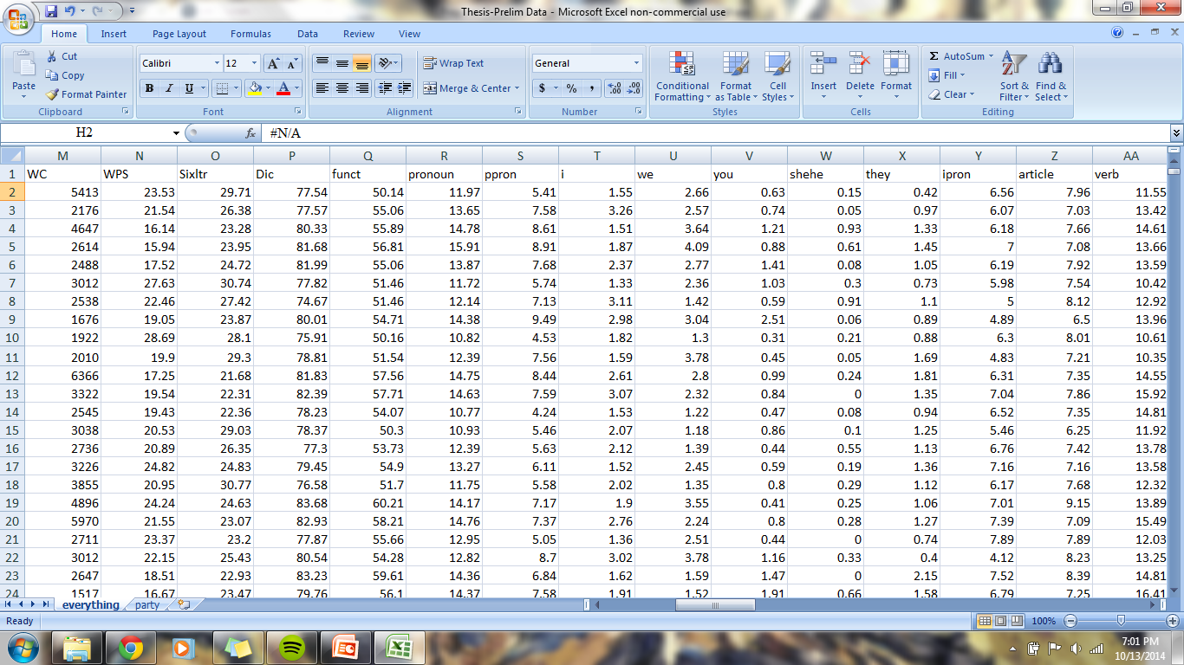
Data

Slide 10
Study1
THE SENATE:
U.S. relations with the following countries: Iraq (198), Kosovo (50)
Number of US Senators: 92
Number of Speeches by Party Affiliation: Republican (136), Democrat (111)
Word count: M = 1757.54, SD = 1427.26, Mdn = 1483.00, Min = 124, Max = 12215
THE HOUSE:
Congressional Record, speeches in the House from 1998 to 2013 (458)
U.S. relations with the following countries: Iraq (331), Libya (106), Kosovo (32)
Number of US Representative: 290
Number of Speeches by Party Affiliation: Republican (211), Democrat (258)
Word count: M = 757.54, SD = 1135.55, Mdn = 510, Min = 97, Max = 12165

Slide 11
Analyses
Dependent Measures
Voting records (Kosovo, Iraq, Libya)
Independent Measures
Linguistic processes, Pronouns, Verbs, Other function words, Social/emotional words, Cognitive mechanisms, Relativity words, and Personal concerns
Multilevel Logistic Regression
Notes:
Combine Method and Results

Slide 12
Results
THE SENATE:
Pronouns: third person singular (he, him, she, her)
THE HOUSE:
Pronouns: third person singular
Personal concerns: money, death
Social words: family, neighbor, friends

Slide 13
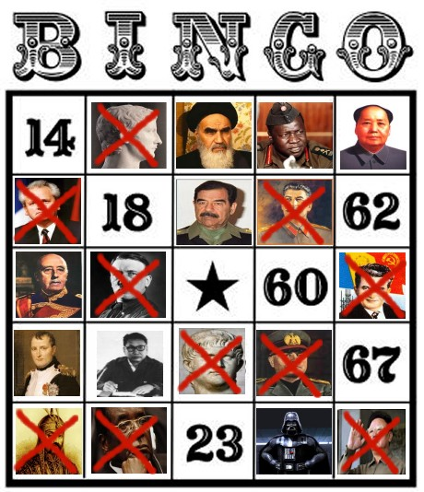
Discussion
Pronouns
Increased third-person singular pronouns, increased probability of support of war
Emphasis on eliminating evil dictators
wingsoverscotland.com/wp-content/uploads/2012/02/salmondbingo1.jpg

Slide 14



Study 2
Iran ≈ 230
North Korea ≈ 120
Possible to increase sample size
with data from foreign affairs
committee hearings
Iraq ≈ 2400

Slide 15
Metalinguistic Constructs

Slide 16
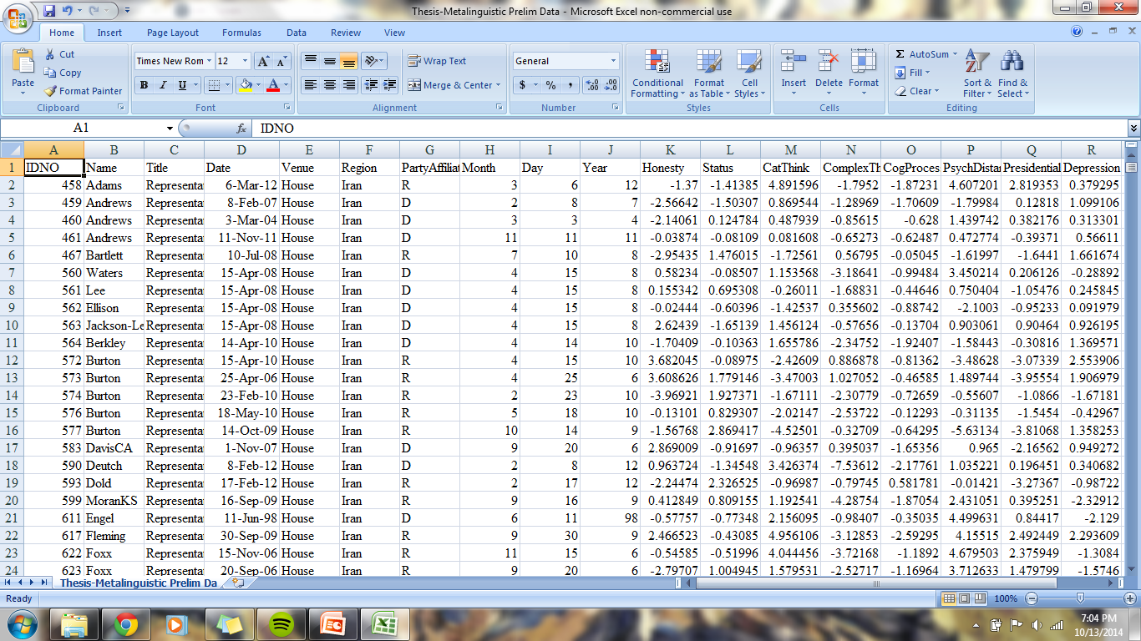
Constructs

Slide 17
ANalyses
Dependent measures: metalinguistic constructs
Independent measures: time, party, venue
Two part data analysis:
Find an objective way to pick important dates using spline curves
Analyze data around those dates for independent measure differences

Slide 18
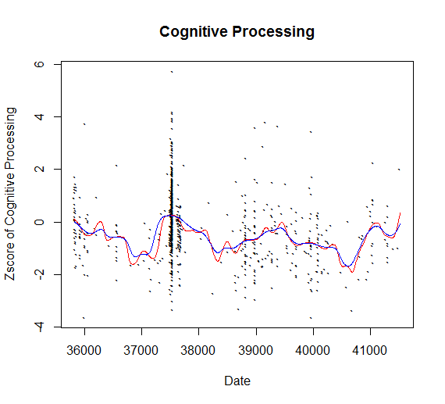
Ksmooth

Slide 19
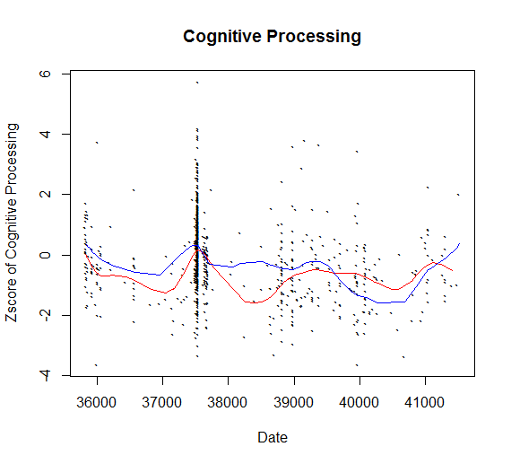
Smooth spline

Slide 20
What do we want?
1) How do you know which smoothing function is best?
2) How do you get the corresponding x value for the peaks/valleys?
3) What do we do about correlated error terms?

Slide 21
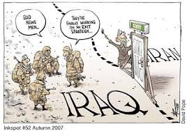
Outcomes
Understanding political language trends over time in the realm of foreign policy
Determining how events impact political language
Exploring how members of the U.S. Congress relate to “rogue” states

